Slide 1


SAP Full-Stack Developer training
ABAP on HANA, UI5 & Fiori, Analytics with OData
Anubhav Oberoy
Day – 11

Slide 2

Agenda – Day 11
OIA Scenario ( Open Item Analysis )
Articulate Requirement for OIA
Execute OIA on ABAP
SQL Console
Introduction to HANA Database User
Data Modeling
Attribute View
Analytics View
Calculation View
Graphical Calculation Views
Scripted Calculation Views
Classification of Join
---Break---
Creation and execution of Data Models
Showing Concept of currency conversion
Concept of Dimensions and Measures
Implementing OIA Using Calculation View
Concept of Delivery Unit

Slide 3

OIA Scenario - Open Item Analysis
Mr. James (Account Receivable Accountant)
Mr. James is a 63 year old men, working in our Toronto office since last 30 years of service. He lives in downtown near the lake in his own 680 Sq yard home. He is a proud father of 2 girls which are studying. And drives Audi A6.
He is a seasonal Skiing player.
Cash has a very important role in a company for running business. It is in the best interest of the company to collect the pending dues from their customers as soon as possible. By putting this Cash back into the system, the company can execute is ambitions and expansion plans faster. So Mr. James is here working as an account receivable accountant, his job is to manage customer accounts and remind them for their unpaid bills when the bill amount OR the average days for unpaid invoices are passed. Classify these customers based on their ability to pay pending bills.

Slide 4
Articulate Requirement for OIA
Create a DB table which stores the customizing – Threshold – Days, Amount
How long on average basis the invoices are outstanding – UNPAID
Invoices which are unpaid – SNWD_SO_INV_HEAD Payment_Status = ‘’
Calculate the average open days since when they are unpaid – Sum / Count
Business partners and company names for those invoice SNWD_BPA
Check the total gross amount of invoices which is open in “common currency”
Invoice header to identify the unpaid invoices – SNWD_SO_INV_HEAD
For each invoice read the line items from SNWD_SO_INV_ITEM and convert to common currency.
Currency conversion based on customizing will be done for items
A total open amount will be calculated in common currency (gross_amount)
Business partner information to find which co. SNWD_BPA
Classify the customers which are at high risk
5. Dunning – Reminders / calls for making payment
COLLECT statement in ABAP.??

Slide 5
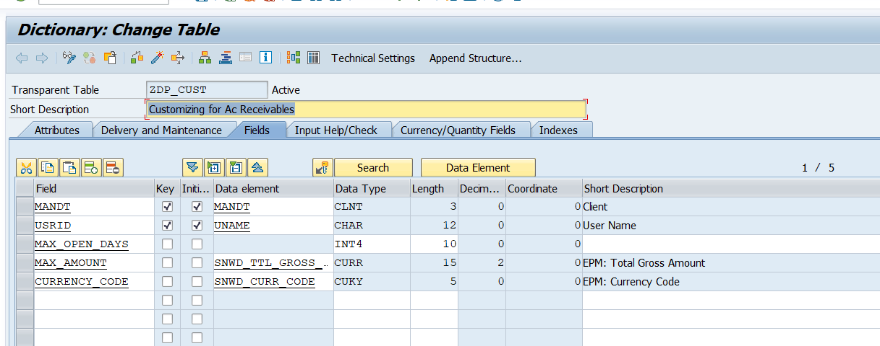
Custom Table for OIA

Slide 6

Exercise
OIA Scenario

Slide 7

Modeling
Challenges with ABAP Coding / SQL Queries
Not everyone is so experienced to write optimized SQL query
Sometimes, we do incorrect nesting unknowingly which cause a recurring DB calls
Many colleagues are not from ABAP background with coding skills
Let someone else optimize the queries for us for DB
Easy way to write complex requirements any one can develop w/o much experience
Modeling is a field of Database engineering which allows developers/consultants to build a graphical model w/o getting too much into technical stuff. The system will then compute the model and generate DB objects automatically which are also optimized to get best performance.

Slide 8
Models in SAP HANA
01
Attribute View
02
Analytic View
03
Calculation View

Slide 9
Why 3 Models?
Processed inside JOIN engine
Is to read master data and joins must faster than any other views
We must mark key field while developing attribute views
Add calculations also
5 types of Joins
01
Attribute View.
Most powerful view type
Multi purpose, read any source
table, other view
Processed in calculation engine
Have lots of build in functions
2 Types of Calculation Views :
Graphical
Scripted
03
Analytic View
Processed inside OLAP/Analytic engine
Is to read combination of transaction and master data
Good performing Aggregations like SUM, MIN, MAX, COUNT, AVG
Perform Currency conversion
Run Analytics on top
Calculation View.
02
https://archive.sap.com/documents/docs/DOC-73509#:~:text=For%20all%20other%20cases%20Analytical,foundation%20node%20allows%20views%2Ftables.

Slide 10








Joins in HANA
03
Right Outer join
04
Temporal join
08
Referential join
08
07
Text join
03
05
07
04
02
06
02
Left Outer join
01
05
Spatial join
01
Inner join
06
Star join

Slide 11
Classification of Joins in HANA
Inner join- Intersection of two tables, fetch exact matching column data from joined tables.
Left outer Join – will fetch intersection + extra data from left table which has no matching records in right table
Right Outer Join – will fetch intersection + extra data from right table which has no matching records on left side
Temporal Join – This join enables a join with TIME dimension, in HANA there are M* tables which represent time dimension.
Spatial Join – Join geo stationary coordinate to calculate distances, locations, area, ..
Star Join – When we have more than one analytic views to be joined, we use star join.
Text Join – Text always used to join text tables, which has language specific description. System automatically pass the current login language to the join and text table. We need to mark language column while doing this join.
A
B
A
B
A
B

Slide 12
Classification of Joins in HANA
8. Referential Join – is a smart INNER JOIN. The join will be executed as inner join when columns from both tables are
selected in the query. But when the query has selected ONLY columns from one of the table alone, the join will be pruned (abandoned/ignored)
BookingID | Date
10001 | 01.03.2021
10002 | 02.04.2021
10003 | 03.04.2021
FlightDate | Airline
01.03.2021 | FedEX
02.04.2021 | DHL
04.04.2021 | FFFL
HANA View – AT_FF
Inner Join – Join is always applied Referential Join
Q1 - SELECT bookingId, Airline From AT_FF
FedEx
DHL
Q2 – Select BookingID from AT_FF;
10001
10002
JOIN is BOUND to HAPPED
Q1 - SELECT bookingId, Airline From AT_FF
FedEx
DHL
Q2 – Select BookingID from AT_FF;
10001
10002
10003

Slide 13

Break

Slide 14
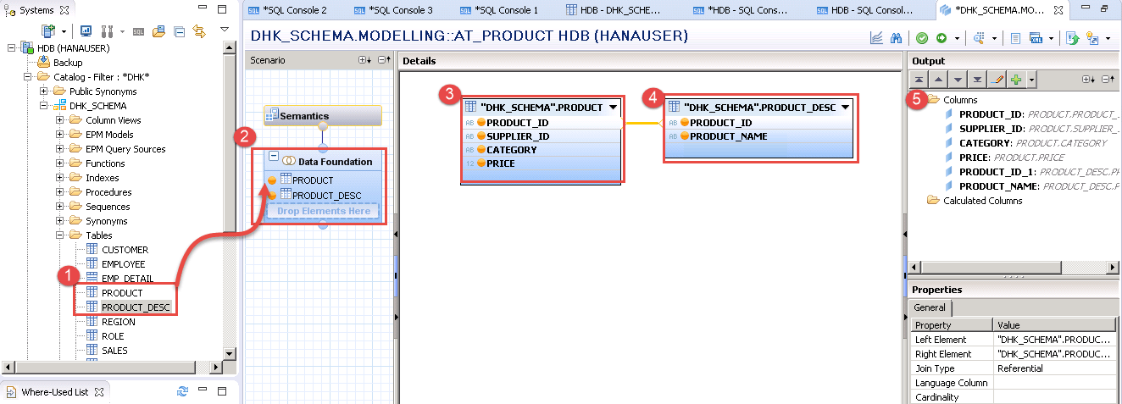
Attribute View
Attribute views provide descriptive data about the characteristics of data in your database. This is “master data” that defines things like hierarchies that describe relationships between data elements. By constructing attribute views, you create dimensions from which subsequent views can be constructed.

Slide 15
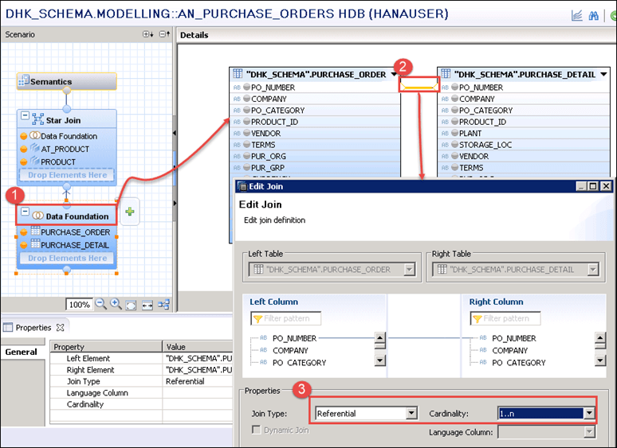
Analytic View
Analytic views in SAP HANA are optimized for aggregating mass data. Because the database is so fast, it’s not necessary to store aggregates in the database; rather, you aggregate on the fly in memory. Analytic views construct a central master “fact table” with key figures. You can use expressions, operators, and functions to analyze this data.

Slide 16
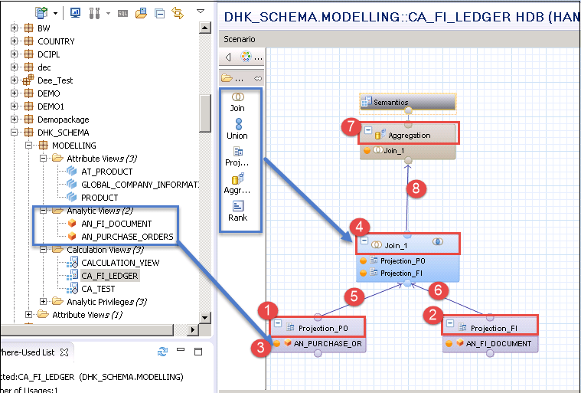
Calculation View
Calculation views provide a way to do flexible, complex logic in the database. They are built on top of one or more analytic or attribute views and allow you to do calculations after aggregation and grouping. Calculations are generally done after grouping at the attribute level and after aggregation at the analytic level.

Slide 17

OIA Scenario Using Calculation View
Mr. James told about me to the CIO of the company last week on Christmas dinner. The CIO is very impressed by listening my stories how I helped Mr. James. Now he want me to help him as well.
He called me for a 1:1 meeting this morning. He was a secret task by the CEO of the co. Since quite a long time there were multiple escalations going on in co. for unpaid bills to their vendors and also customers who are unhappy due to unavailability of stocks.

Slide 18
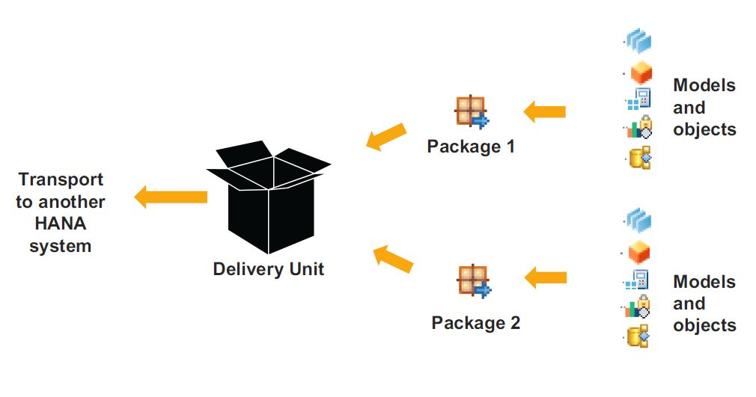
Concept of Delivery Unit
Delivery units are SAP HANA specific packages that can be used to install content, transport data models and applications developed on the SAP HANA platform. The delivery unit management window can be accessed through the 'Modeler Perspective' in SAP HANA Studio.

Slide 19

End of Day 11

Slide 20

Questions

Slide 21

Anubhav Oberoy

Slide 22


We’re committed to empower you to be
Most Desirable Resource
through powerful training solutions.
We build the workforce of the future.
250+
Corporate Clients
30,000+
Learners Trained
25000+
Learners Placed
FREE WEBINARS
Sign up for free webinars with industry experts every fortnight!
Enroll Now!
Contact us today!
https://anubhavtrainings.com/

Slide 23




More from AnubhavTrainings.com

